Slide 1
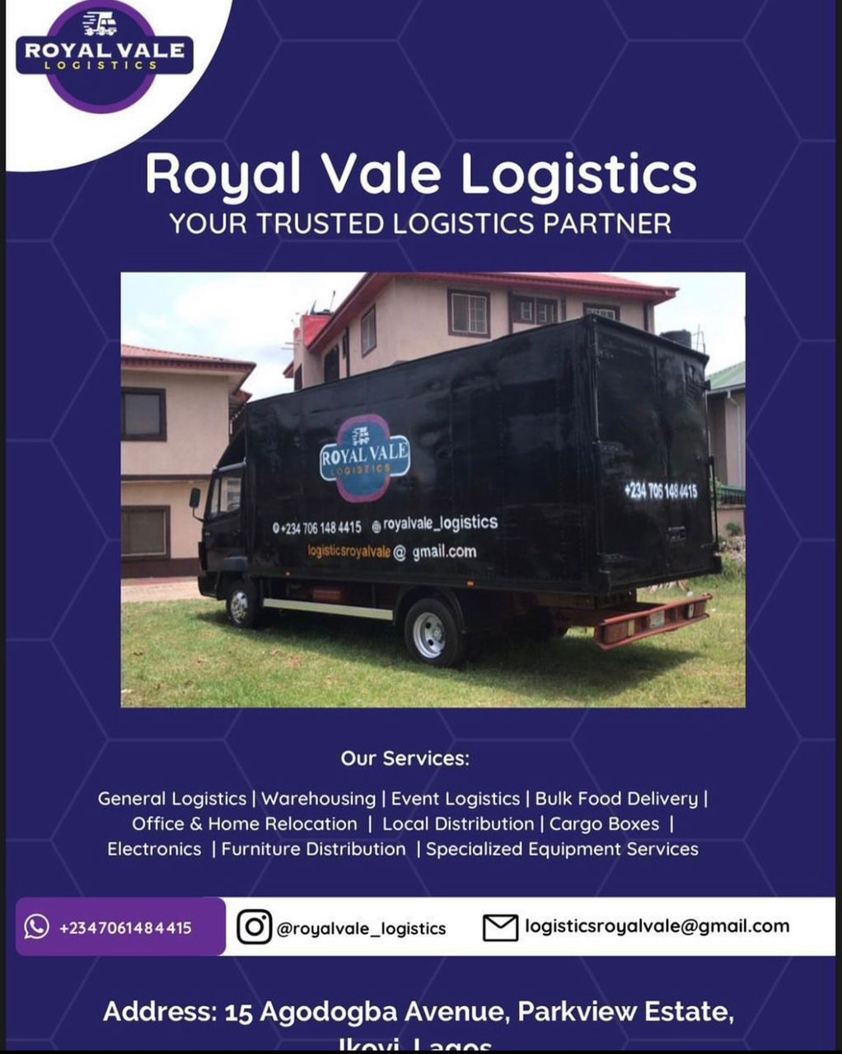
Royal Vale Logistics
Expansion

Slide 2
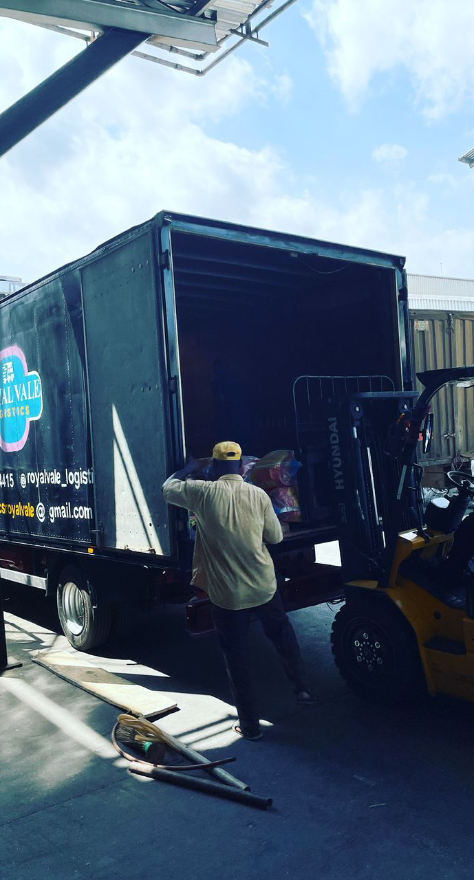
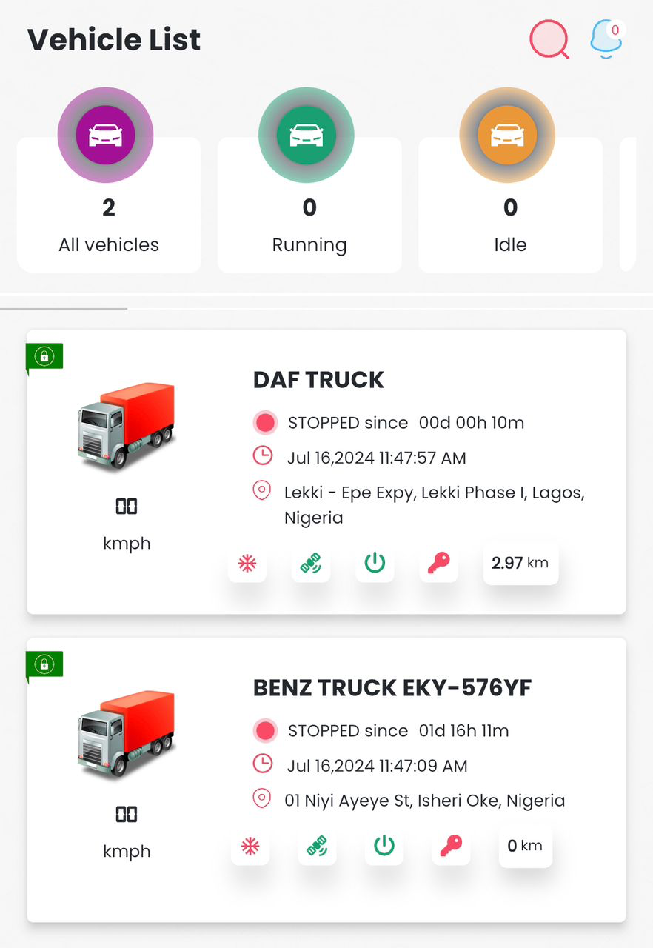
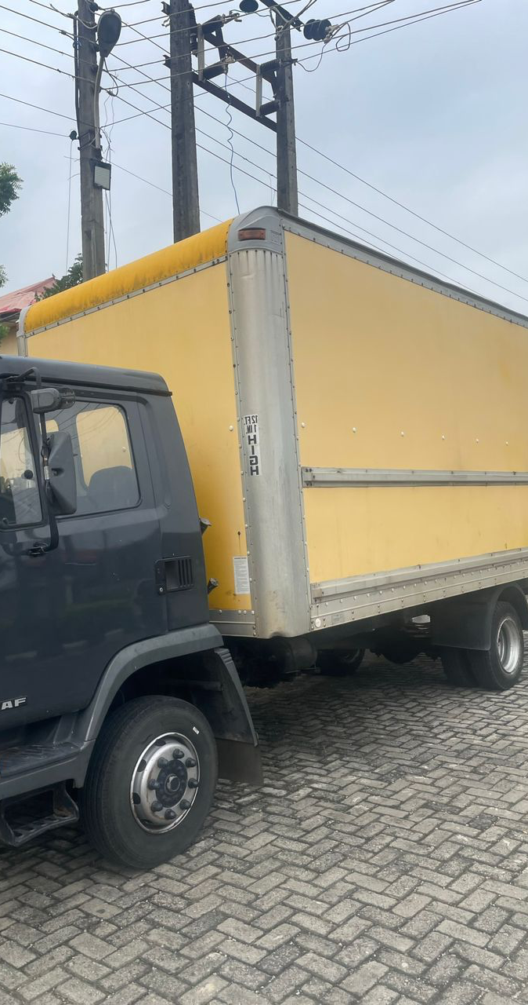
Current Fleet & Software
Mercedes 7-Tonne Truck
DAF 7- Tonne Truck
Fleet Management tool

Slide 3
Expansion Plan
Fleet Expansion Trucks
Purchase of additional 10-tonner
Purchase of 15 tonner
Maintenance Tools and Facilities
Expand and upgrade existing facilities
Insurance
Secure additional Coverage for new vehicles
Technology and Software
Global Positioning Systems
Purchase of 5x GPS Trackers
Infrastructure Loading and Unloading Equipment
Purchase of a Forklift
Purchase of Trollies
Marketing & Advertising
Ongoing Marketing Campaigns
Personnel:
Hire and train additional drivers
Expand maintenance crew
Hire logistics coordinator
Compliance and Legal
Obtain Permits and Licences
Ensure Regulatory & Environmental Compliance

Slide 4
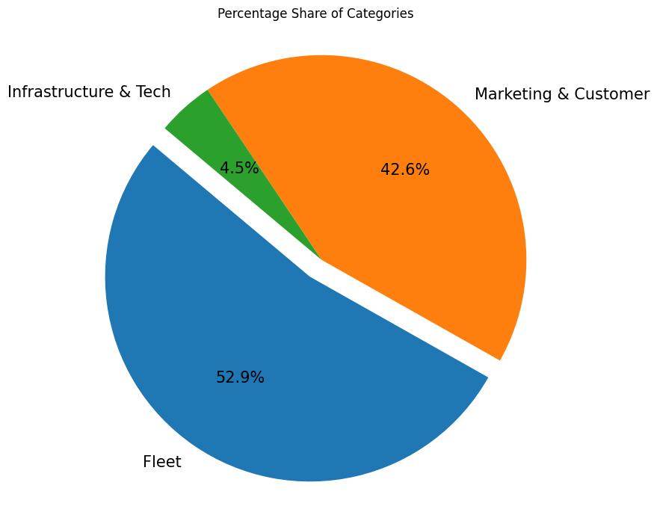
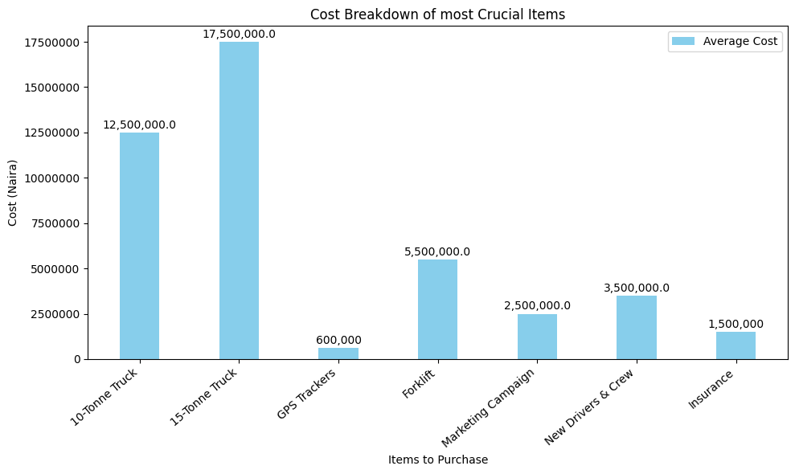
Cost Breakdown
Fleet
Item | Quantity | Unit Cost (N)
10 – Tonne Truck | 1 | N14,000,000 – N20,000,000
15 - Tonne truck | 1 | N21,000,000 – N25,000,000
Insurance | 4 (trucks) | N4,000,000
New Drivers & Crew | 3 | N3,500,000
Marketing & Customer
Item | Quantity | Unit Cost(N)
Customer Relationship Management |  | N2,500,000
Marketing Campaign | X6 (months) | N3,000,000
Infrastructure & Tech
Item | Quantity | Unit Cost(N)
Pallet Jacks | 2 | N200,000 – N350,000
Forklift | 1 | N4,000,000 – N7,000,000
Conveyor Belts | 1 | N2.5,000,000
GPS Units for Trucks (Fleet Mgt Systems) | 5 | N125,000 x5 = N600,000

